Slide 1


REAL-TIME TRAFFIC
A Business Case for New Market Entry

Slide 2


(يَا أَيَّتُهَا النَّفْسُ الْمُطْمَئِنَّةُ ارْجِعِي إِلَى رَبِّكِ رَاضِيَةً مَرْضِيَّةً فَادْخُلِي فِي عِبَادِي وَادْخُلِي جَنَّتِي)
Eng / Ahmed Salama
1/12/2025

Slide 3



Slide 4






OUR TEAM
Ahmed Salama
Role: Data Analysis
Sara Hisham
Role: Data Analysis
Dr-Zakaria Yehia
Role: Data Analysis
Yousef Ahmed
Role: Data Analysis

Slide 5



OUR TEAM
Mohamed Nasr Aldin
Sherif Gamal
Osama Hegazy
Role: Data Processing
Role: Data Modeling
Role: Data Cleansing

Slide 6




EXECUTIVE SUMMARY
01
02
03
Introduction
Data Warehouse
Data Analysis

Slide 7

🎯 Project Idea
Build a modern data pipeline for UK traffic data.
Transform raw traffic counts into clean, structured, and analytics-ready data.
Enable decision-makers to monitor traffic patterns, congestion, and vehicle trends.
Support planning, route optimization, and real-time insights using a scalable BI model.
___________________________________________________________________________________
📥 Data Source
Data sourced from the UK Department for Transport (DfT) open traffic data.
Contains:
Vehicle counts
Road information
Locations & coordinates
Local authorities & regions
Timestamps (date, hour)
view

Slide 8




Benefits of the Real-Traffic Project
Commuters and Drivers
Public Transportation Authorities
Emergency Services
Citizens & Local Communities
Gain access to reliable insights about traffic trends, helping them choose better routes, avoid congestion, and reduce travel time.
Use traffic volume patterns to optimize bus routes, schedule timings, and improve service reliability.
Police, ambulance, and fire departments can identify high-risk areas, reduce response time, and plan safer, faster routes.
Benefit from safer roads, reduced congestion, and better quality of life through smarter city planning.

Slide 9






TOOLS
Python
SQL Server
Power Bi
ArcGIS Online
Github
Used for cleaning, transforming, and preparing the raw traffic data before loading it into the database
Used to store the structured data (Silver layer), create relationships, build the data model, and enforce data integrity
Used to visualize the cleaned data, build dashboards, and generate insights for decision-making.
Used to map traffic locations geographically and visualize traffic volume spatially.
Used for version control, documentation, and sharing the full project with the team.

Slide 10


Data Warehouse
Presented by: Osama Hegazy Mohamed Nasr Eldin
Sherif Gamal

Slide 11
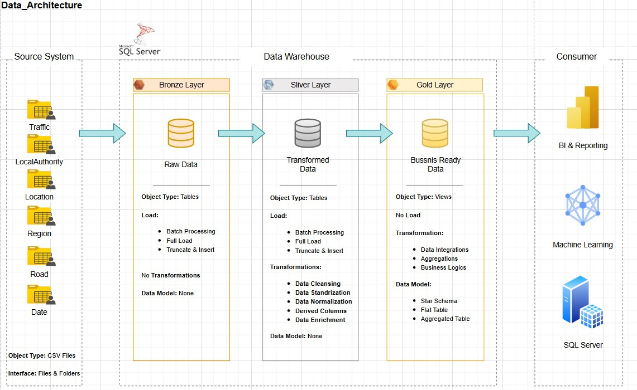
Data Modeling

Slide 12
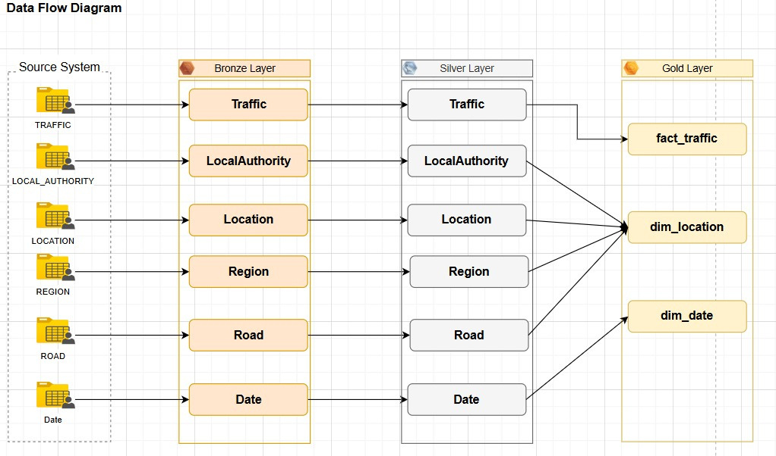

Data Flow Diagram

Slide 13
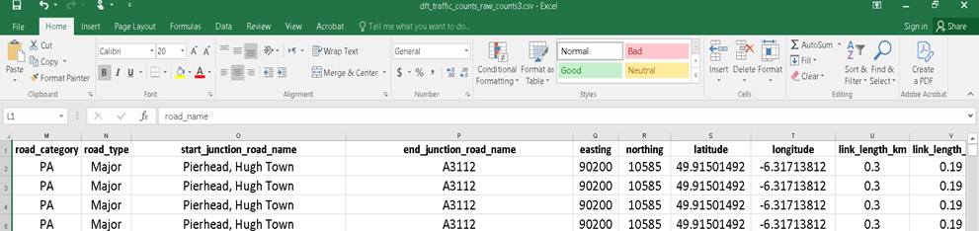
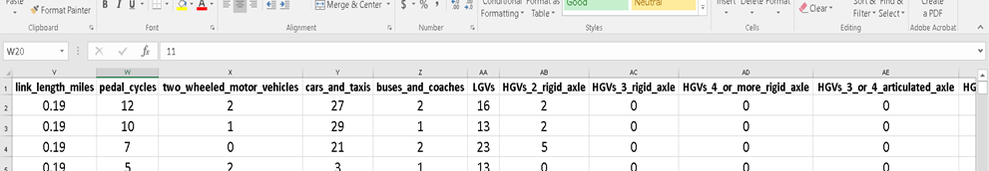
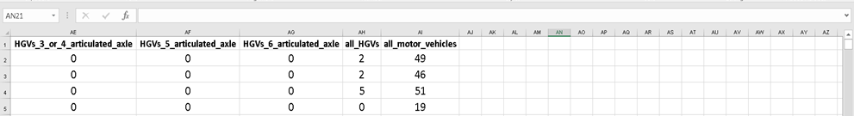
Bronze layer (Raw Data )

Slide 14




🎯 SILVER
LAYER
⭐ What is the Silver Layer?
“ The Silver Layer is the cleaned, structured, and normalized version of the data.
It transforms raw, messy CSVs into a relational model ready for analysis.
🚧 Main Problems in the Data (Challenges)
No primary keys in most tables
Duplicate rows across several table
Inconsistent formats
Missing relationships between tables
Date formats not unified
Text fields inconsistent (uppercase/lowercase)
Mixed data types
(numbers stored as text)
The raw data had no unique identifiers → impossible to build relationships.
Especially in Location, Date, and LocalAuthority.
Traffic table not directly connected to Region, Road, Date, etc.

Slide 15




”
🛠️ How we Solved These Problems
Create Surrogate Keys
Define Relationships (Star Schema)
Step 1—Clean the Raw Data
Export Clean Data for SQL Server
Because no table had a natural primary key, I generated IDs:
Traffic_id
Road_id
Region_id
Local_authority_id
Location_id
Date_id
Removed duplicates from all tables
Standardized date format (YYYY-MM-DD)
Converted text and numeric fields to correct data types
Mapped the relationships using the surrogate keys:
Traffic → Road
Traffic → Region
Traffic → Location
Traffic → Date
Traffic → Local Authority
Saved all cleaned tables as CSVs
Ensured proper column order
Used BULK INSERT for fast loading

Slide 16

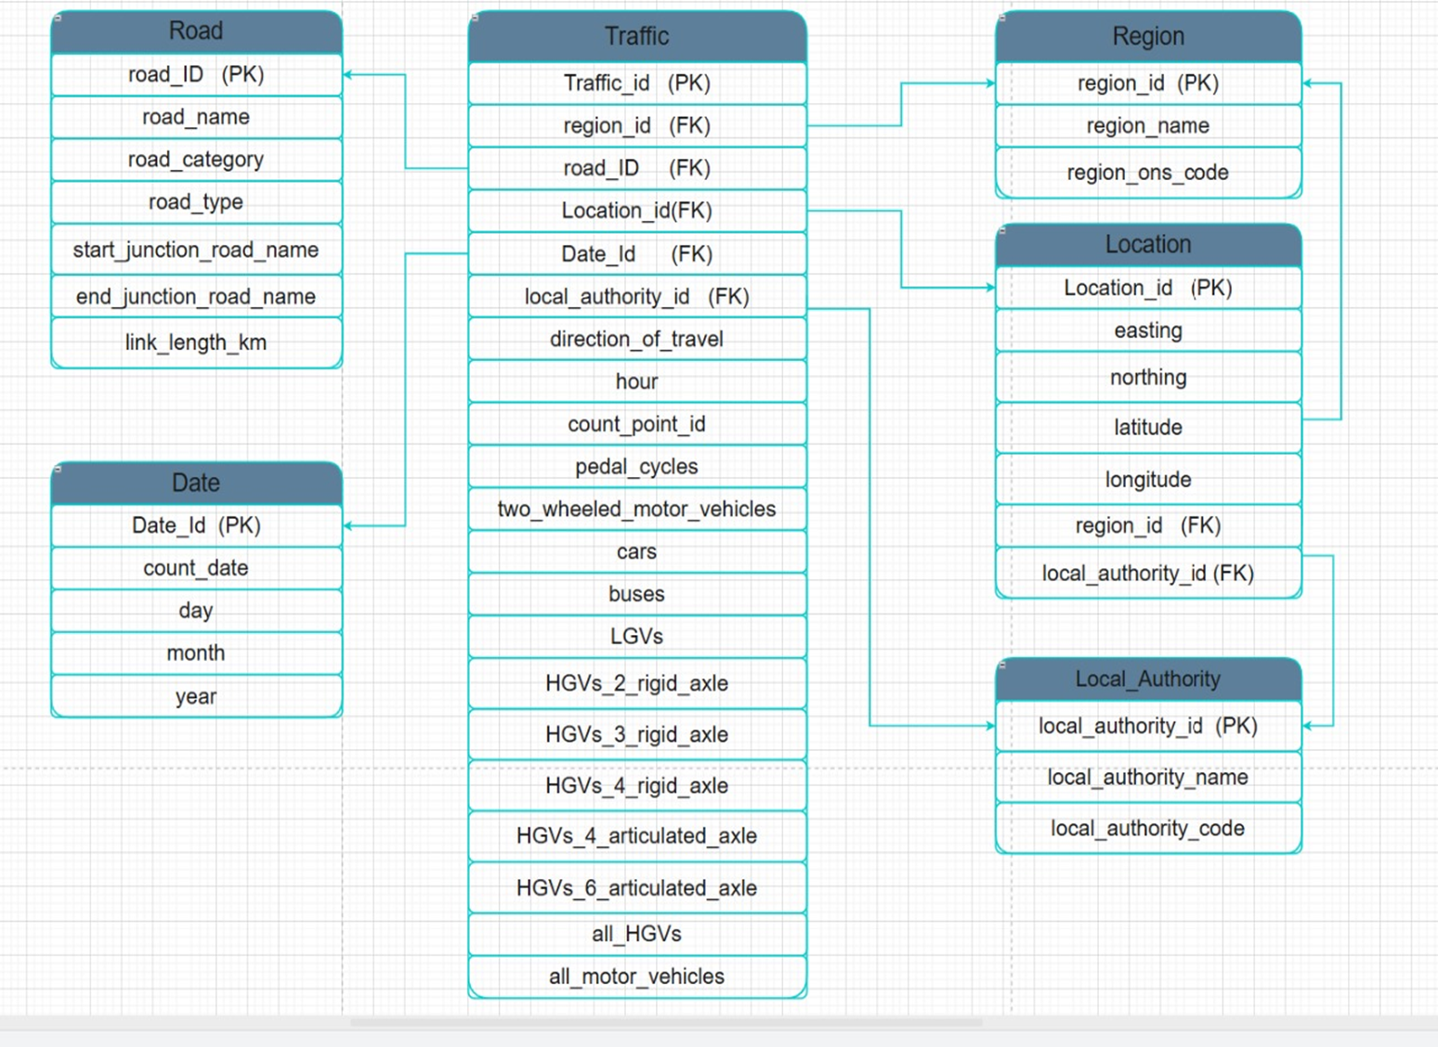
STAR SCHEMA

Slide 17
🥇 Gold Layer
⭐ What is the Gold Layer?
“The Gold Layer contains business-ready, aggregated datasets optimized for dashboards and decision-making.”
⚡ How the Gold Layer Helps Power BI
Reduces refresh time
Improves visual responsiveness
Enables advanced analytics
Makes the dashboard easier to understand for end users

Slide 18

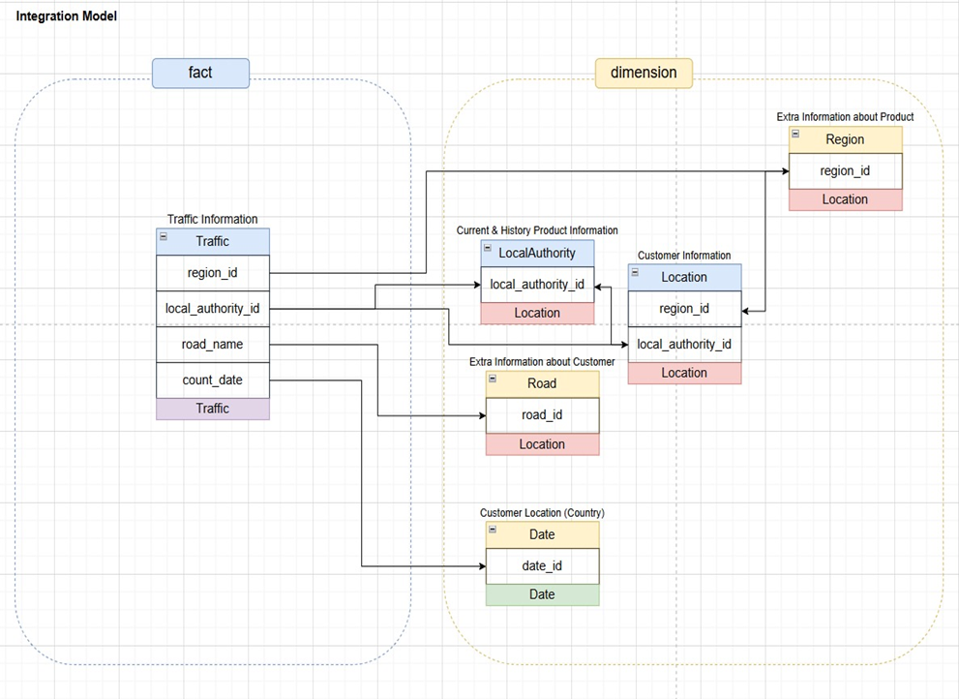
Integration Model

Slide 19
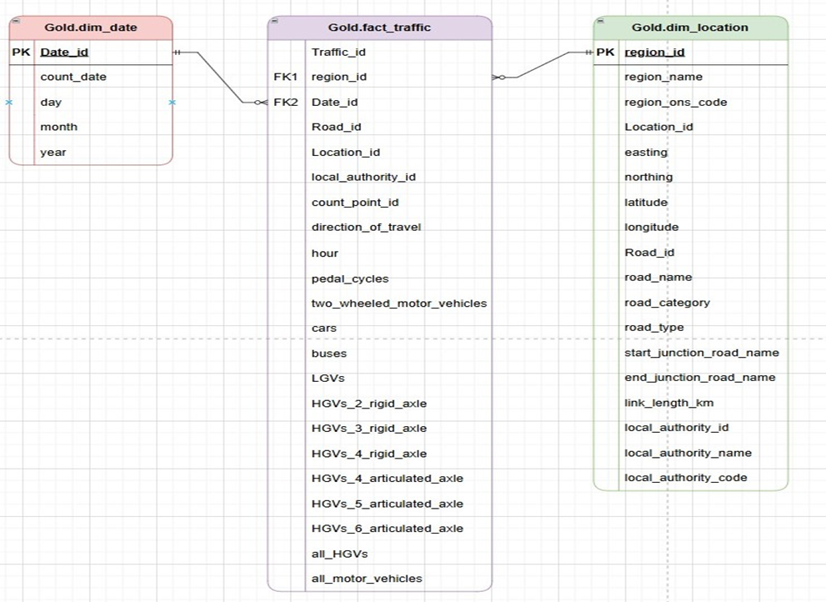
Gold Views

Slide 20
Data Analysis
Presented by: Zakaria Yehia
Sara Hisham
Yousef Ahmed
Ahmed Salama

Slide 21
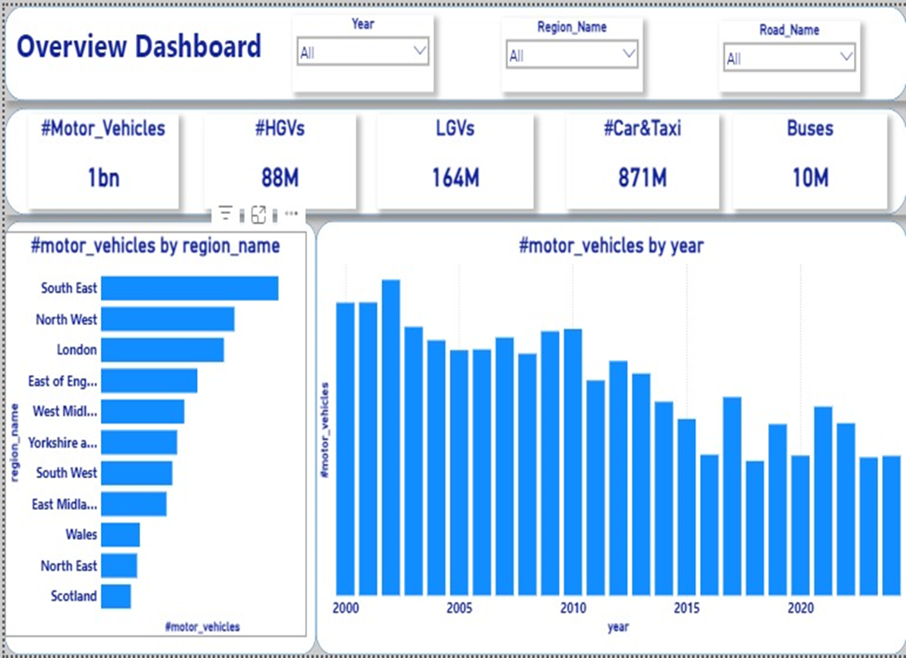
Power Bi Dashboard

Slide 22
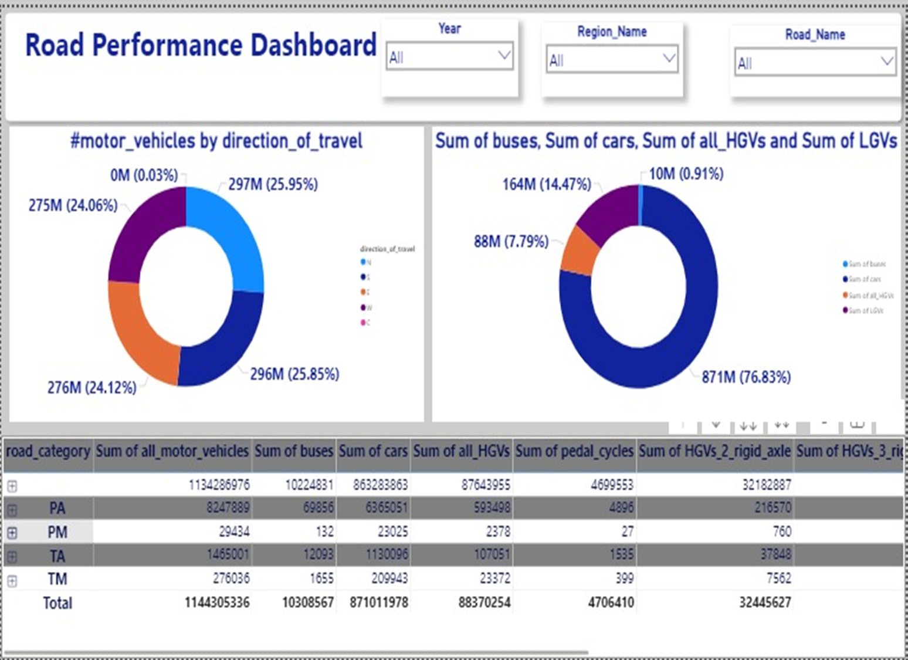

Slide 23
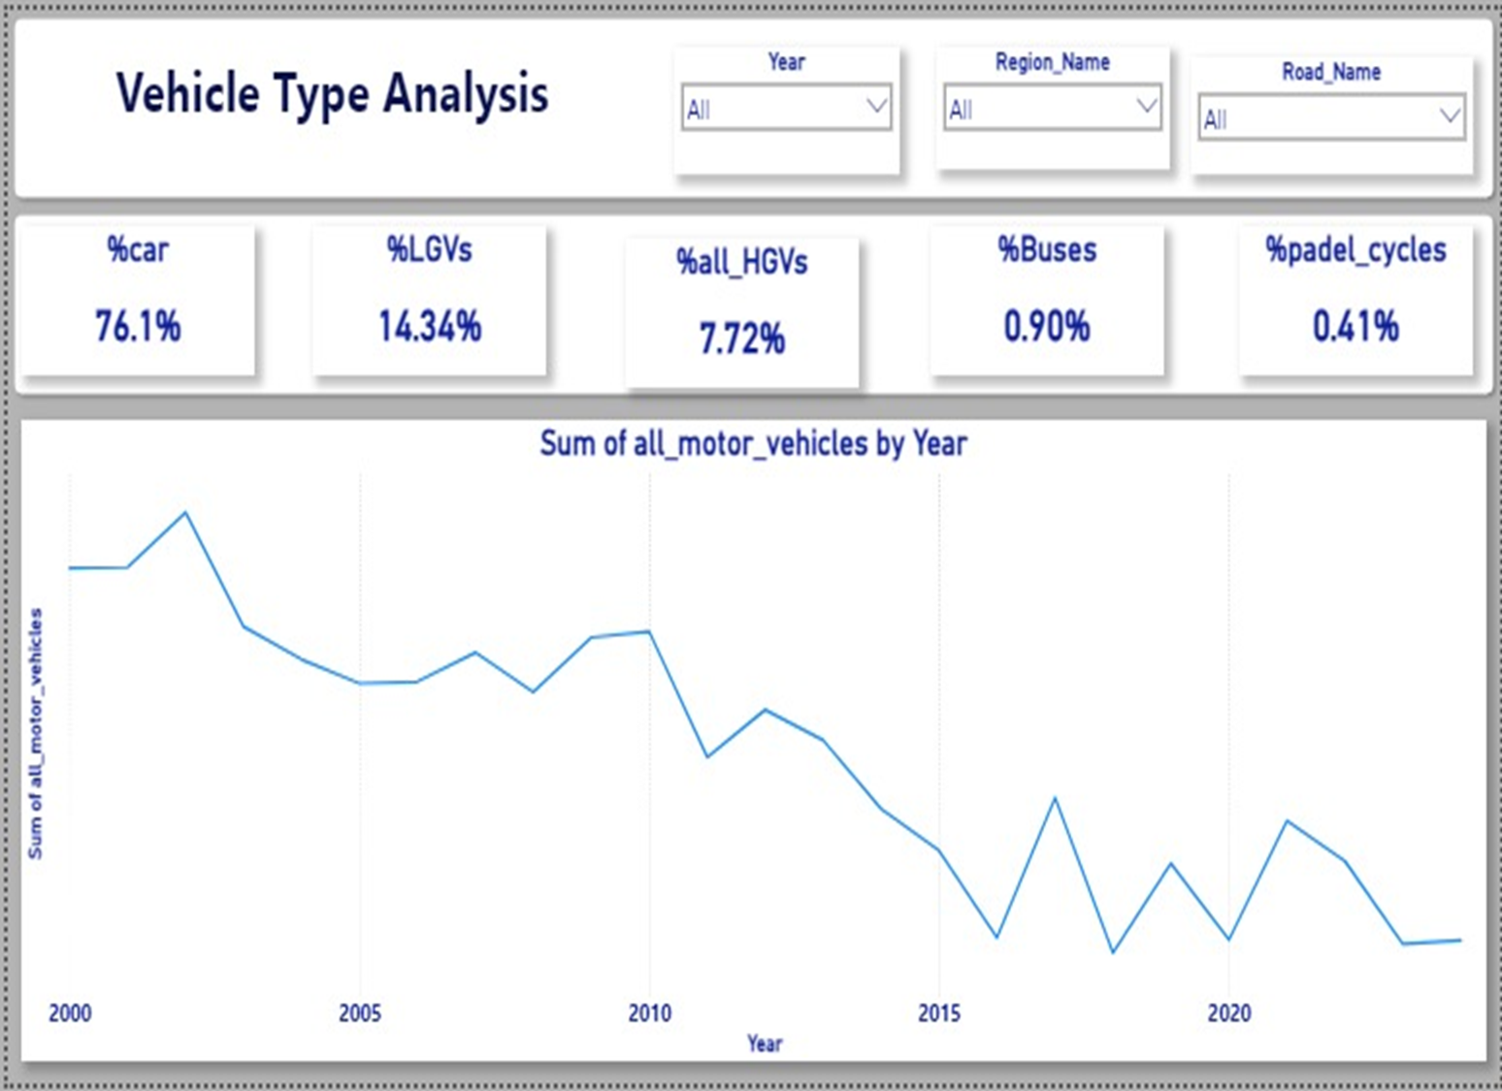

Slide 24
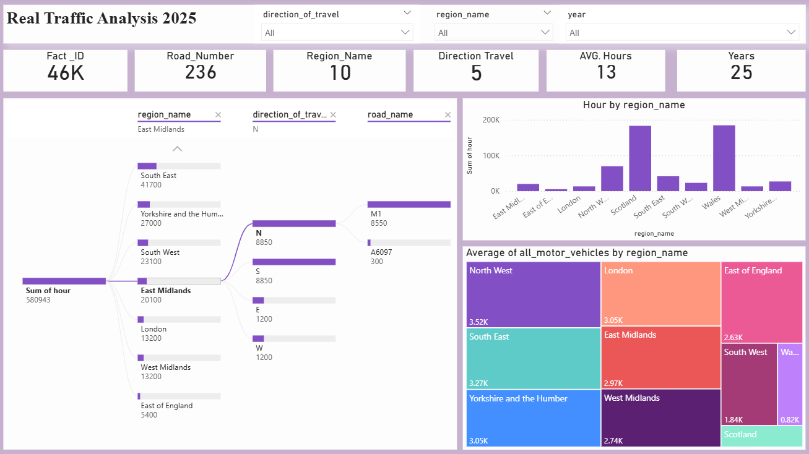

Slide 25
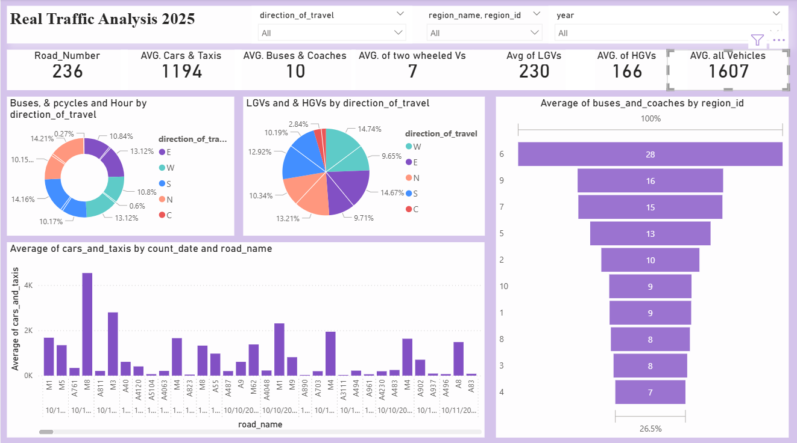

Slide 26
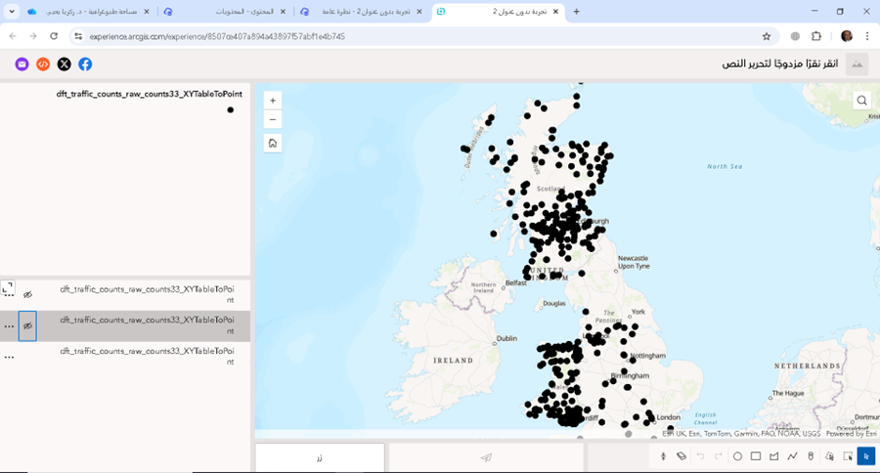
🗺️ARCGIS
ONLINE
🌍 Why ArcGIS Online?
ArcGIS Online was used to visualize the traffic data geographically, helping us understand patterns based on location.

Slide 27
Thank you
100%

